Slide 1

OBJECTIVES

Slide 2
OBJECTIVES
This Analysis aims to discover factors that lead to employee ATTRITION and explore important questions such as
- Average Salary
- Mean Distance from home
- Average Age

Slide 3

DATA CLEANING

Slide 4

DATA CLEANING
Employee
Performance Rating
DATASET
Rating Level
Satisfied Level
Education Level

Slide 5
DATA CLEANING
Employee
Performance Rating
Rating Level
Satisfied Level
Education Level
EmployeeID
FirstName
LastName
Gender
Age
BusinessTravel
Department
DistanceFromHome (KM)
State
Ethnicity
EducationField
JobRole
MaritalStatus
SalaryStockOptionLevel
OverTime
Education
HireDate
Attrition
YearsAtCompany
YearsInMostRecentRole
YearsSinceLastPromotion
YearsWithCurrManage
PerformanceID
EmployeeID
ReviewDate
EnvironmentSatisfaction
JobSatisfaction
RelationshipSatisfaction
TrainingOpportunitiesWithinYear
TrainingOpportunitiesTaken
WorkLifeBalance
SelfRating
ManagerRating
RatingID
RatingLevel
SatisificationID
SatisficationLevel
EducationLevelID
EducationLevel

Slide 6

ANALYSIS QUESTIONS

Slide 7
ANALYSIS QUESTIONS
19.Does Education Field impact attrition?
20.Does years since last Promotion play a role in attrition?
21. How Does Job role impact attrition?
22.Does marital status impact attrition?
23. How does Training Times Last Year influence Attrition?
24.Does Education Field impact attrition?
25.How does the stockoption Level affect attrition?
1.What is the attrition rate across different age groups?
2.How does Salary affect attrition?
3.How does distance from home affect attrition?
4.Does education level affect attrition?
5.Does gender play a role in employee attrition?
6.How does overtime impact attrition?
7.Which department has the highest attrition rate?
8.How does job satisfaction affect attrition?
9.How does Environment Satisfaction affect attrition?
10.How does Relationship Satisfaction affect attrition?
11.How does Work Life Balance affect attrition?
12.How does business travel frequency impact attrition?
13.What is the relation between the employees BusinessTravel and their job satisfaction level?
14.what is the percentage of different satisfaction levels among employees?
15.what is the percentage of different Work Life Balance levels among employees?
16.What is the relation between self-rating and manager rating?
17.What is the relation between attrition and years with current managers?
18.How does the stockoption Level affect attrition?

Slide 8

Exploratory
Data Analysis

Slide 9
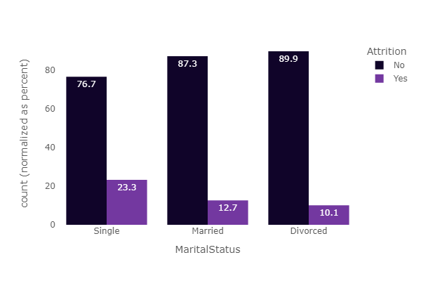
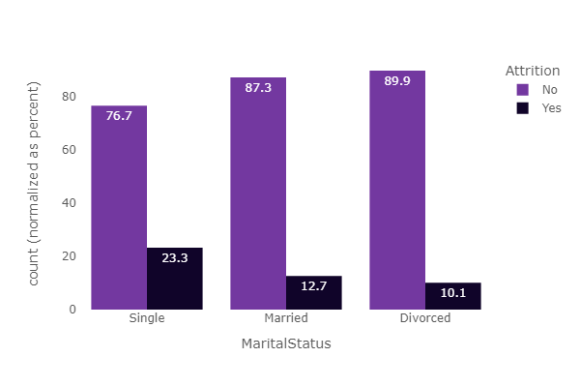

Slide 10
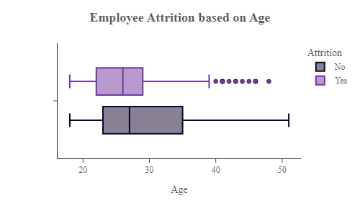

Slide 11

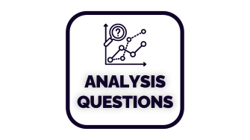

Attrition
Salary
Age
Gender
Job Role
Home Distance
Department
Marital Status
Educational
Business Travel
Overtime
Educational Field
Last Promotion
Ethnicity
State
Stock Level
HR Dataset
Exploratory
Data Analysis

Slide 12
Attrition
Salary
Age
Gender
Job Role
Home Distance
Department
Marital Status
Educational
Business Travel
Overtime
Educational Field
Last Promotion
Ethnicity
State
Stock Level
HR Dataset
Exploratory
Data Analysis

Slide 13
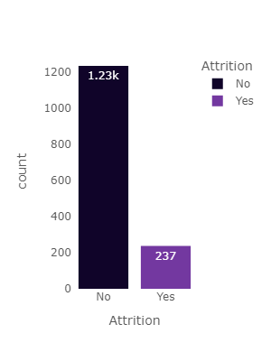
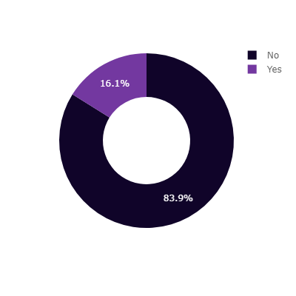
HR Dataset
Attrition
Salary
Age
Gender
Job Role
Home Distance
Department
Marital Status
Educational
Business Travel
Overtime
Educational Field
Last Promotion
Ethnicity
State
Stock Level

Slide 14


Attrition
Salary
Age
Gender
Job Role
Home Distance
Department
Marital Status
Educational
Business Travel
Overtime
Educational Field
Last Promotion
Ethnicity
State
Stock Level
HR Dataset

Slide 15
HR Dataset
Attrition
Salary
Age
Gender
Job Role
Home Distance
Department
Marital Status
Educational
Business Travel
Overtime
Educational Field
Last Promotion
Ethnicity
State
Stock Level

Slide 16
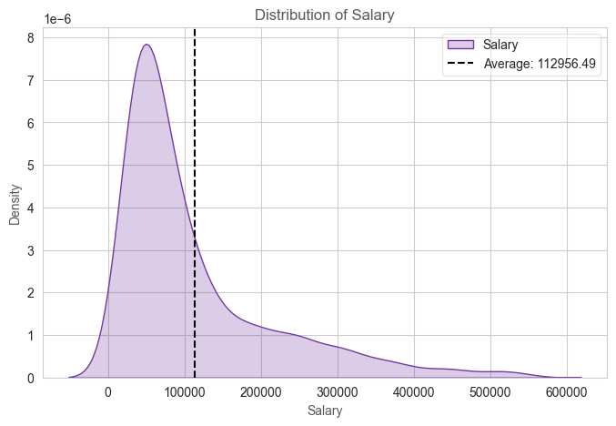
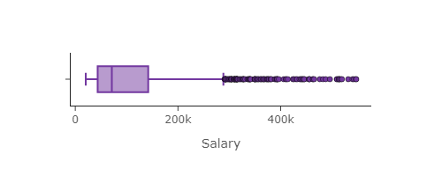
HR Dataset
Attrition
Salary
Age
Gender
Job Role
Home Distance
Department
Marital Status
Educational
Business Travel
Overtime
Educational Field
Last Promotion
Ethnicity
State
Stock Level
Salary Box Plot shows that the major Employees range has small Range, from 43K to 142 k

Slide 17
HR Dataset
Attrition
Salary
Age
Gender
Job Role
Home Distance
Department
Marital Status
Educational
Business Travel
Overtime
Educational Field
Last Promotion
Ethnicity
State
Stock Level
With High Average Salary of 112.956 K

Slide 18
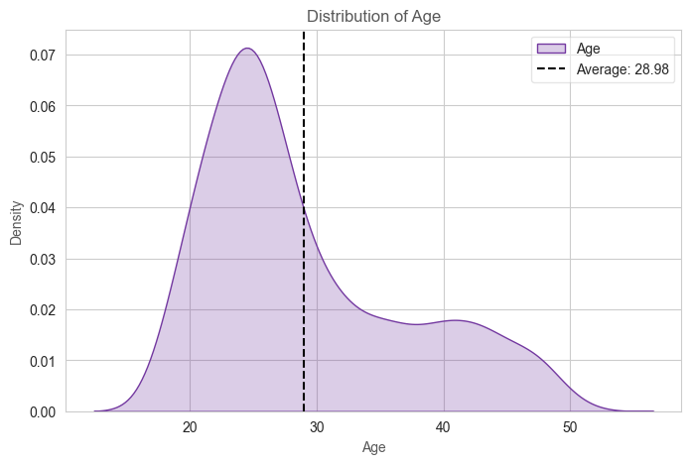
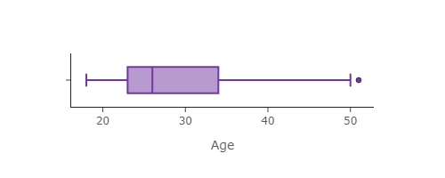
HR Dataset
Attrition
Salary
Age
Gender
Job Role
Home Distance
Department
Marital Status
Educational
Business Travel
Overtime
Educational Field
Last Promotion
Ethnicity
State
Stock Level
Age Box Plot shows that the major Employees range is 23 – 34 Years with Median Age of 26 Years
With High Average Salary of 112.956 K

Slide 19
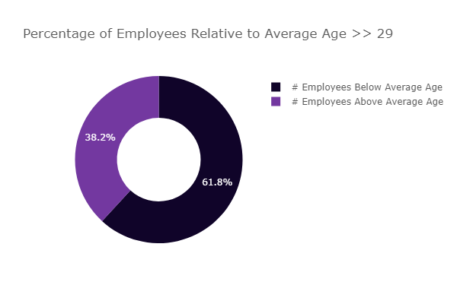
HR Dataset
Attrition
Salary
Age
Gender
Job Role
Home Distance
Department
Marital Status
Educational
Business Travel
Overtime
Educational Field
Last Promotion
Ethnicity
State
Stock Level
With Average Age of 29.98 Years
With High Average Salary of 112.956 K

Slide 20
HR Dataset
Attrition
Salary
Age
Gender
Job Role
Home Distance
Department
Marital Status
Educational
Business Travel
Overtime
Educational Field
Last Promotion
Ethnicity
State
Stock Level
We Divided Employees Into 2 Categories:
Above Average Age
Below Average Age
With High Average Salary of 112.956 K

Slide 21
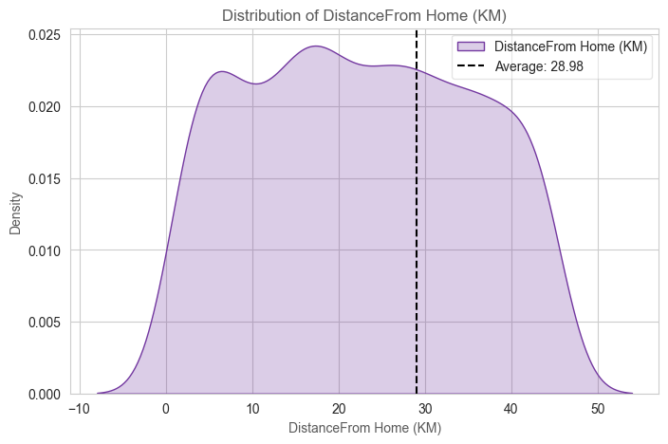
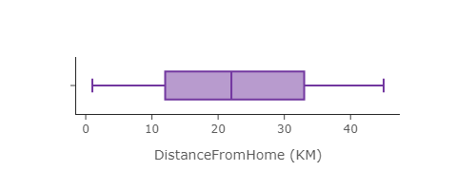
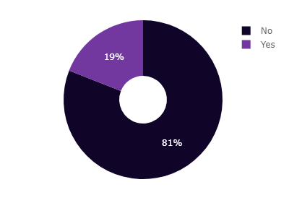
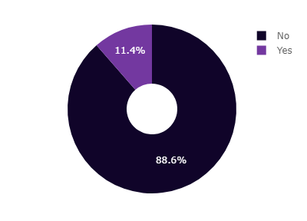
HR Dataset
Attrition
Salary
Age
Gender
Job Role
Home Distance
Department
Marital Status
Educational
Business Travel
Overtime
Educational Field
Last Promotion
Ethnicity
State
Stock Level
Attrition for BELOW Average Age Group
Attrition for ABOVE Average Age Group
We Divided Employees Into 2 Categories:
Above Average Age
Below Average Age

Slide 22
HR Dataset
Attrition
Salary
Age
Gender
Job Role
Home Distance
Department
Marital Status
Educational
Business Travel
Overtime
Educational Field
Last Promotion
Ethnicity
State
Stock Level
From Box Plot and Distribution, we can See that Distance from Home has wide Range and quite far Average of 28.98 km

Slide 23

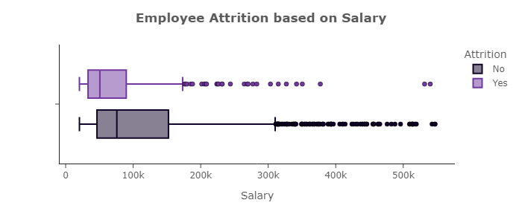
HR Dataset
Attrition
Salary
Age
Gender
Job Role
Home Distance
Department
Marital Status
Educational
Business Travel
Overtime
Educational Field
Last Promotion
Ethnicity
State
Stock Level
The Shift to the Left in Yes Box Plot indicates that the low salary Affect on the Attrition Rate of Employees

Slide 24
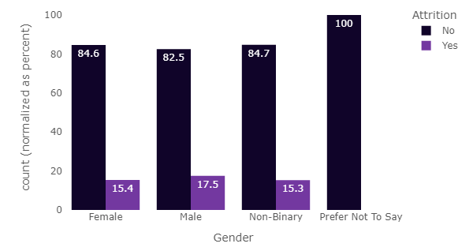
HR Dataset
Attrition
Salary
Age
Gender
Job Role
Home Distance
Department
Marital Status
Educational
Business Travel
Overtime
Educational Field
Last Promotion
Ethnicity
State
Stock Level
The Shift to the Left in Yes Box Plot indicates that Younger Employees tends to Attire, and the Narrow Spread in the Box indicates that this phenomena appears strongly on Employees

Slide 25
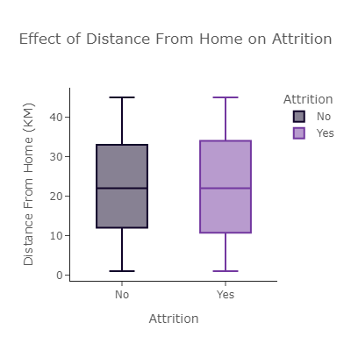
HR Dataset
Attrition
Salary
Age
Gender
Job Role
Home Distance
Department
Marital Status
Educational
Business Travel
Overtime
Educational Field
Last Promotion
Ethnicity
State
Stock Level
Males has the Highest Attrition Rate

Slide 26
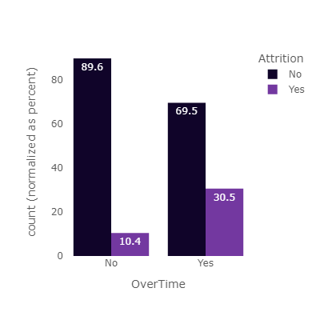
HR Dataset
Attrition
Salary
Age
Gender
Job Role
Home Distance
Department
Marital Status
Educational
Business Travel
Overtime
Educational Field
Last Promotion
Ethnicity
State
Stock Level
Pox Plot doesn’t Shows a difference between Employees who leave the Company and others who don’t, based on Distance from Home.

Slide 27
HR Dataset
Attrition
Salary
Age
Gender
Job Role
Home Distance
Department
Marital Status
Educational
Business Travel
Overtime
Educational Field
Last Promotion
Ethnicity
State
Stock Level
30.5% of Employees Who Work Overtime tend to Attire, Which is Very High Percentage

Slide 28
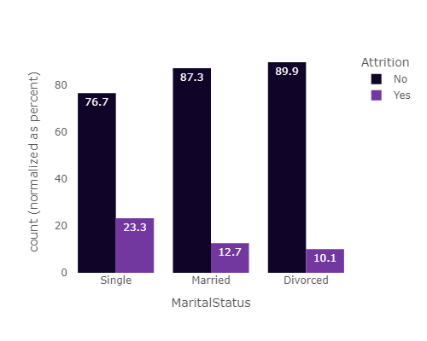
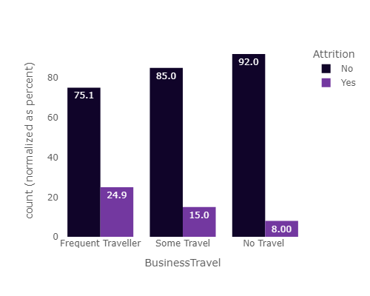
HR Dataset
Attrition
Salary
Age
Gender
Job Role
Home Distance
Department
Marital Status
Educational
Business Travel
Overtime
Educational Field
Last Promotion
Ethnicity
State
Stock Level
The more frequently an employee travels, the higher the likelihood of them to Attire.

Slide 29
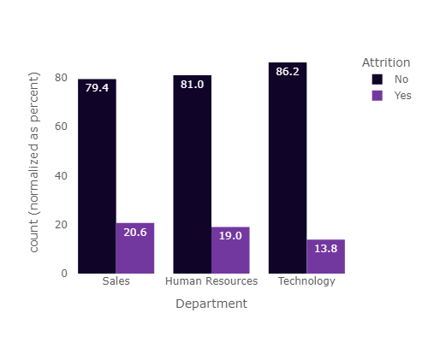
HR Dataset
Attrition
Salary
Age
Gender
Job Role
Home Distance
Department
Marital Status
Educational
Business Travel
Overtime
Educational Field
Last Promotion
Ethnicity
State
Stock Level
Single Employees has the Highest Attire Ratio with 23.3%

Slide 30
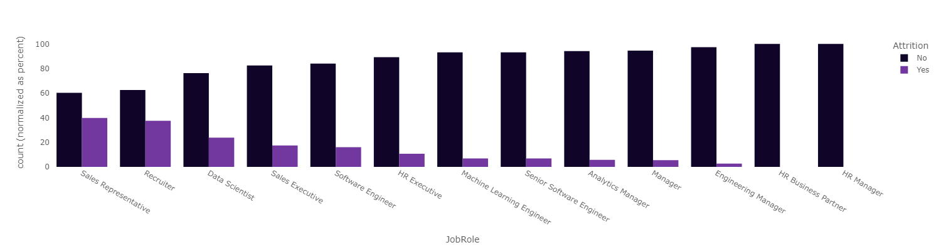
HR Dataset
Attrition
Salary
Age
Gender
Job Role
Home Distance
Department
Marital Status
Educational Level
Business Travel
Overtime
Educational Field
Last Promotion
Ethnicity
State
Stock Level
Sales and Human Resources have a relatively High Attrition Ratio

Slide 31
HR Dataset
Attrition
Salary
Age
Gender
Job Role
Home Distance
Department
Marital Status
Educational Level
Business Travel
Overtime
Educational Field
Last Promotion
Ethnicity
State
Stock Level
Sales, Representative, Recruiter, Data Scientist, Sales Executive and Software Engineer Job Roles Have the Highest Attrition Rate

Slide 32
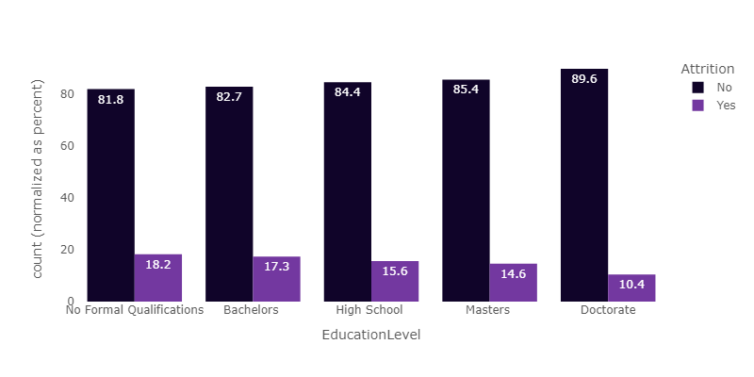
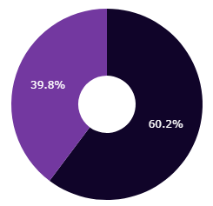
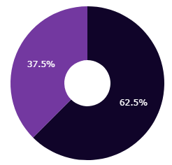
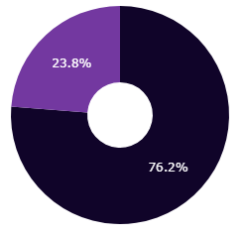
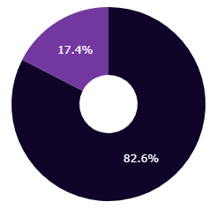
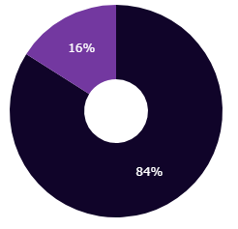
HR Dataset
Attrition
Salary
Age
Gender
Job Role
Home Distance
Department
Marital Status
Educational Level
Business Travel
Overtime
Educational Field
Last Promotion
Ethnicity
State
Stock Level
Pie Charts Shows the Exact Percentage of these Five Job Roles
Sales Representative
Recruiter
Data Scientist
Sales Executive
Software Engineer

Slide 33
HR Dataset
Attrition
Salary
Age
Gender
Job Role
Home Distance
Department
Marital Status
Educational Level
Business Travel
Overtime
Educational Field
Last Promotion
Ethnicity
State
Stock Level
Higher Educational level (Master, Doctorate) has low attrition rate.
Sales Representative
Recruiter
Data Scientist
Sales Executive
Software Engineer

Slide 34
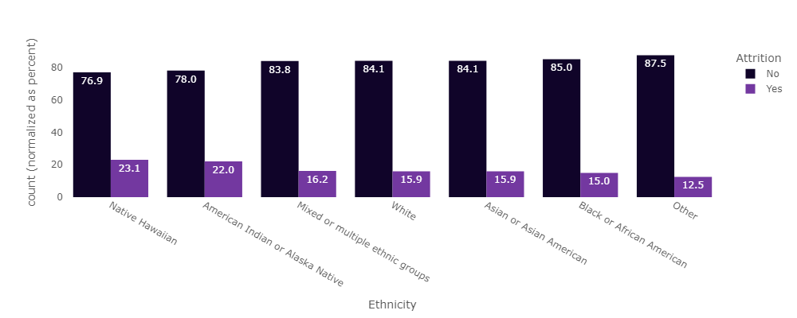
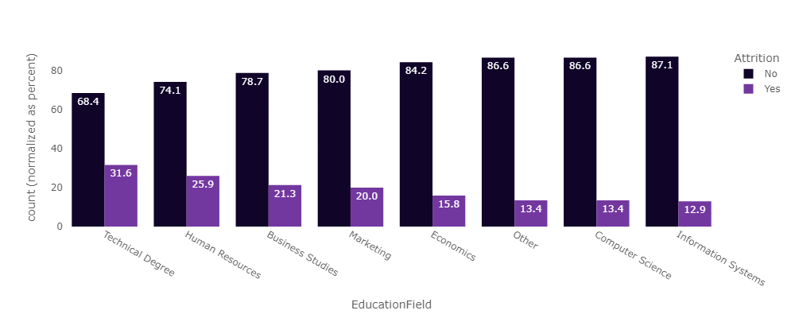
HR Dataset
Attrition
Salary
Age
Gender
Job Role
Home Distance
Department
Marital Status
Educational Level
Business Travel
Overtime
Educational Field
Last Promotion
Ethnicity
State
Stock Level
Technical Degree and Human Resources have a very High Attrition Rate

Slide 35
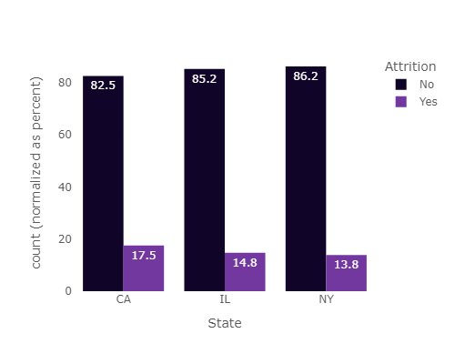
HR Dataset
Attrition
Salary
Age
Gender
Job Role
Home Distance
Department
Marital Status
Educational Level
Business Travel
Overtime
Educational Field
Last Promotion
Ethnicity
State
Stock Level
Native Hawaiian and American Indian Alaska Native have the Highest Attrition Rate

Slide 36
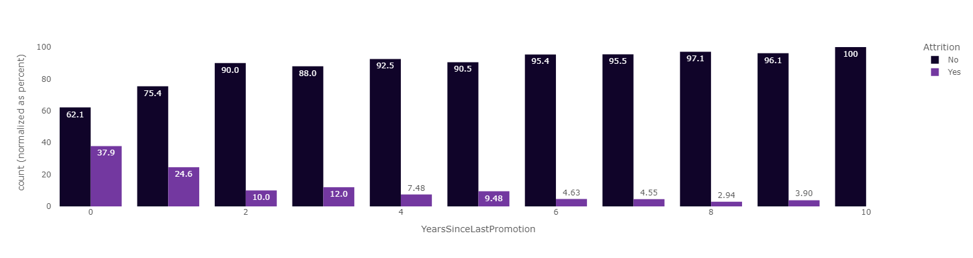
HR Dataset
Attrition
Salary
Age
Gender
Job Role
Home Distance
Department
Marital Status
Educational Level
Business Travel
Overtime
Educational Field
Last Promotion
Ethnicity
State
Stock Level
California has the Highest Attrition Rate

Slide 37
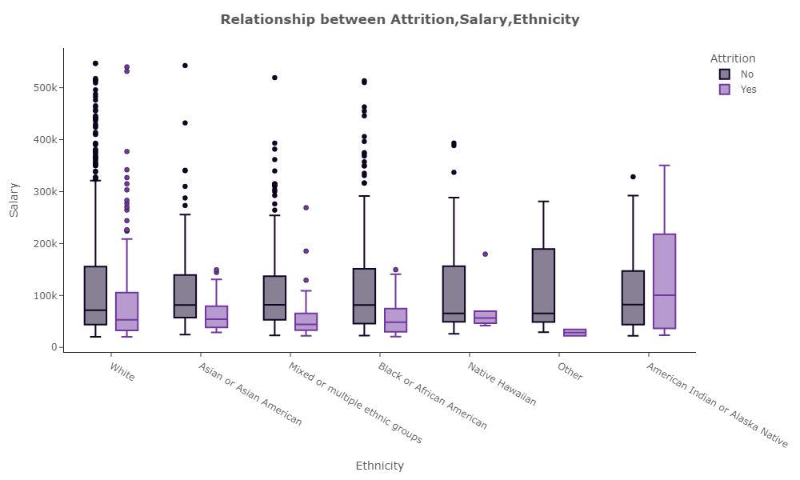
HR Dataset
Attrition
Salary
Age
Gender
Job Role
Home Distance
Department
Marital Status
Educational Level
Business Travel
Overtime
Educational Field
Last Promotion
Ethnicity
State
Stock Level
Huge Number of Employees tends to Attire even before having a chance for Promotion

Slide 38
HR Dataset
Attrition
Salary
Age
Gender
Job Role
Home Distance
Department
Marital Status
Educational Level
Business Travel
Overtime
Educational Field
Last Promotion
Ethnicity
State
Stock Level
The Spread in American Indian Alaska Native Pox Bolt shows that they tend to Attire even though they have highest range of Salary

Slide 39
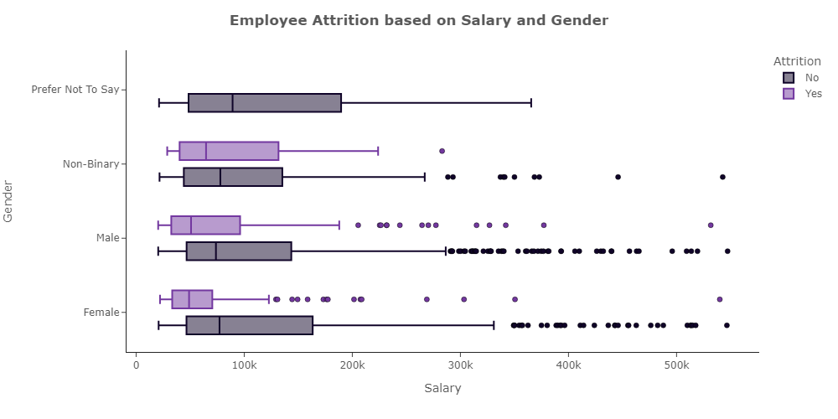
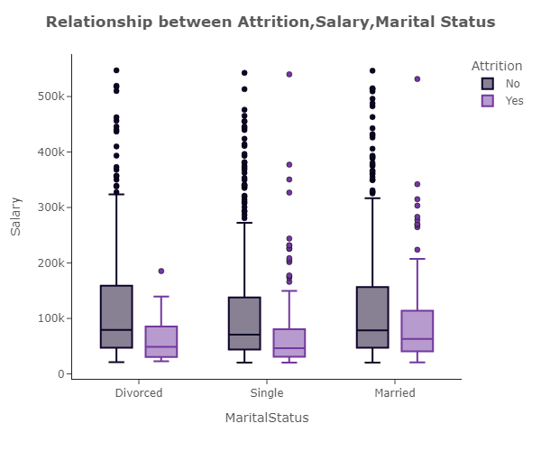
HR Dataset
Attrition
Salary
Age
Gender
Job Role
Home Distance
Department
Marital Status
Educational
Business Travel
Overtime
Educational Field
Last Promotion
Ethnicity
State
Stock Level
Single was the most type who attire and here box shows that they have a quite lower Salary than others

Slide 40
HR Dataset
Attrition
Salary
Age
Gender
Job Role
Home Distance
Department
Marital Status
Educational
Business Travel
Overtime
Educational Field
Last Promotion
Ethnicity
State
Stock Level
Females who Attire have a narrow range of Salary,
Non-Binary tends to Attire Even though they have a quite wide Range of Salary

Slide 41
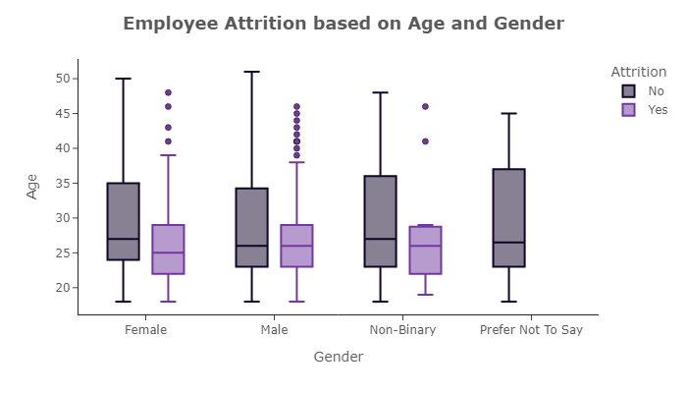
HR Dataset
Attrition
Salary
Age
Gender
Job Role
Home Distance
Department
Marital Status
Educational
Business Travel
Overtime
Educational Field
Last Promotion
Ethnicity
State
Stock Level
There is No Clear Relation between Gender, Age and Attrition

